Slide 1
E343: Elem Math Methods
Week 12, Wednesday
Reading: No new

Slide 2
Agenda
Continuing work on large multiplication
Unpacking the multiplication algorithm for large numbers
Starting on large division

Slide 3
Warm Up with a Partner
Solve 10 x 60 by counting by 60 ten times (Example: 60, 120,…).
One person count and the other person record the counts, then switch roles.
Once both people have counted see if your sequence of 60s agreed and determine what ten sixties is.
Use your answer to ten sixties to determine what thirty sixties would be.
Solve 10 x 60 by counting by 60 ten times (Example: 60, 120,…)
Notes:
Welcome & Opening Remarks
Welcome students to Week 12, Day 2 of the semester. This is an exciting day where we deepen our understanding of multiplication algorithms and begin our exploration of division. Today we’re building on everything we covered Monday about large multiplication, moving from concrete manipulatives through semi-concrete models to the abstract standard algorithm. In the second half of class, we’ll introduce large division, emphasizing the two conceptual types: sharing and measurement division.

Slide 4
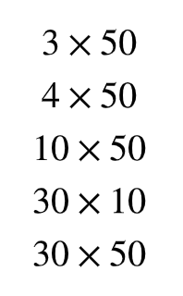
Reasoning Strategy: Number Strings/Cluster Problems
Use known multiplication facts to help determine more complex products.
How could you use these multiplication problems to find 34 x 50?
Make a list of multiplication problems that could help you determine 86 x 42?
Notes:
Agenda Overview (2-3 minutes)
Three Main Parts:
1. Warm-up activity (5 min) – Counting by 60s and connecting to 30 × 60 (foundational number sense)
2. Continuing multiplication work (main focus, ~30 min) – Unpacking the algorithm through models
3. Introduction to large division (~15 min) – Distinguish sharing vs. measurement division

Slide 5
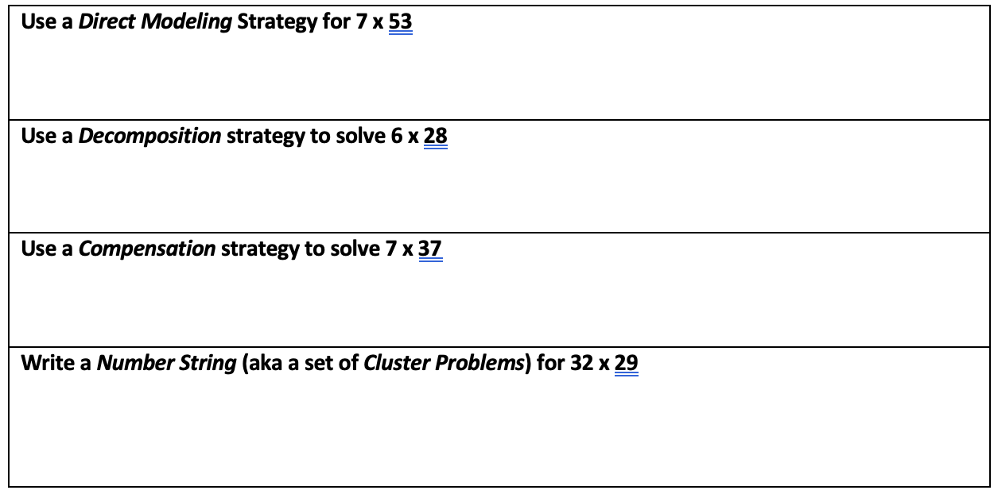
Now You Try…
Notes:
Warm-Up with Partners (5 minutes)
Purpose:
Activate students’ skip-counting skills and help them see the connection between repeated addition (10 × 60) and multiplication. This also preps them to think about the “bundling” concept central to multiplication algorithms.
Facilitation Tips:
- Encourage one partner to count while the other records: 60, 120, 180, 240, 300, 360, 420, 480, 540, 600
- Have them switch roles and verify they get the same answer (600)
- For the extension (30 × 60), guide them: “We know 10 × 60 = 600. What if we have 30 groups of 60? How can we use our answer?” (Answer: 3 × 600 = 1800)

Slide 6
Standard Algorithms for Multiplication (1 of 3)
Example: 13 x 7
P. 31 Unit 3 Packet
Begin with models: Build from equal groups types and base ten blocks, and develop these into connected arrays.
Notes:
Number Strings/Cluster Problems Strategy (10 minutes)
Purpose:
Build computational fluency by leveraging known facts and numerical relationships. Rather than always using the standard algorithm, students learn multiple paths to products using decomposition and partial products (aligned with Van de Walle Chapter 13: Multiplication & Division Computation).
Key Teaching Points:
- For 34 × 50: Students might think "30 × 50 = 1500, then 4 × 50 = 200, so total is 1700"
- For 86 × 42: Break it into parts students can handle mentally or with simple calculations
- This is the "reasoning strategy" before jumping to formal algorithms—it legitimizes flexible thinking
Facilitation Tips:
- Ask students: "What multiplication facts do you already know that could help?"
- Write down ALL student strategies on chart paper—no single "right way"
- Connect this back to Monday's exploration of area models (sets of partial products)
- Emphasize: "We can break big numbers into smaller, easier pieces"
Connection to Broader Curriculum:
This cluster approach is a bridge between concrete/semi-concrete representations and the abstract standard algorithm. Students who understand why partial products work are less likely to make procedural errors in the algorithm.

Slide 7
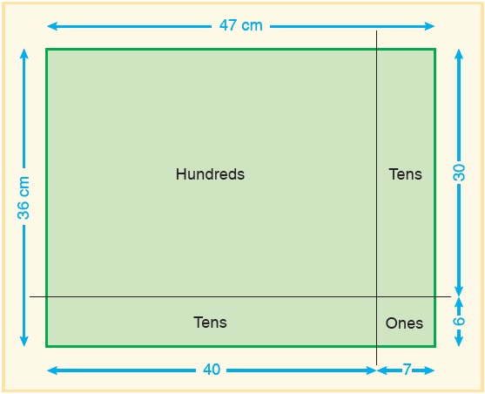
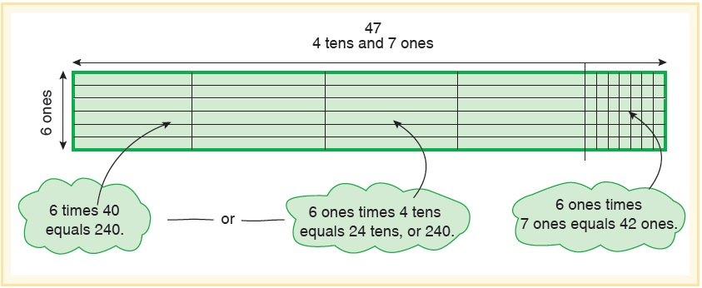
Standard Algorithms for Multiplication (2 of 3)
Begin with models
Area Models: connected and open
Notice the base-ten language
Each section is a partial product
Figure out the size of each sub-rectangle (partial products) and combine to find the whole
Notes:
Now You Try Activity (5 minutes)
Purpose:
Give students a chance to practice the cluster/number string strategy independently or in pairs before moving to the formal algorithm. This is low-stakes practice and formative assessment.
Activity Setup:
- Choose a similar multiplication problem (or similar structure to the examples shown)
- Have students work in pairs
- Circulate and listen for reasoning: Are they breaking numbers efficiently? Are they correctly adding partial products?
Facilitation Tips:
- If a student struggles, ask: "What smaller multiplication problems could you solve first?"
- Celebrate diverse strategies: "I like how you broke this into hundreds first!"
- Note students who still need support with the transition from concrete to abstract—they'll benefit from continued use of base-ten blocks
Transition Note:
Use this activity to gauge readiness. If most students show solid understanding, move confidently into slides 6-8 (standard algorithms with models). If students are hesitant, spend a few more minutes with manipulatives before the abstract algorithm.

Slide 8
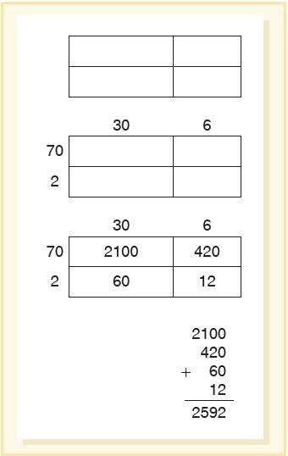
Standard Algorithms for Multiplication (3 of 3)
Open Array:
A semi-concrete representation of the area model
Blank rectangle (not to scale)
Mark off the subdivisions based on the digits in the factors
Record partial products inside each subdivision.
Find the sum of partial products
Notes:
Standard Algorithms for Multiplication (1 of 3): Base-Ten Blocks Introduction (8 minutes)
Purpose:
Introduce the standard algorithm through CONCRETE MODELS (base-ten blocks). This slide begins the critical progression: Concrete → Semi-Concrete (area models) → Abstract (digits and place value notation).
Content Focus: 13 × 7
- Use base-ten blocks: 1 ten and 3 ones, repeated 7 times
- First, physically make 7 groups of 13 using blocks
- Then, collectively regroup: 7 groups of 3 ones (21 ones) = 2 tens and 1 one; 7 groups of 1 ten (7 tens) = 7 tens
- Total: 9 tens and 1 one = 91
Van de Walle Connection (Ch. 13):
Chapter 13 emphasizes the critical role of BASE-TEN STRUCTURE in multiplication. Without concrete understanding of place value and regrouping, the algorithm is just mysterious symbol-pushing. The chapter argues: "Use models to develop understanding before teaching the algorithm."
Facilitation Tips:
- SHOW, don't tell: Have students (or you) build the blocks at the document camera/board
- Use a think-aloud: "I have 7 groups of 13. Let me see... each group has 1 ten and 3 ones. So altogether I have 7 tens and... (count the ones blocks) 21 ones."
- Guide the regrouping: "Can we trade 10 ones for a ten? Yes! So we had 21 ones, now it's 2 tens and 1 one."
- Record the steps alongside the blocks—begin to show notation WITHOUT explaining the algorithm yet
Timing:
This is deliberate, showing-the-thinking work. Take time. Students watching this will be ready to speed up with area models (next slide).

Slide 9
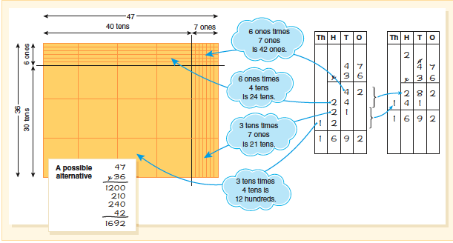
Connecting Multiplication of Multidigit Numbers: Concrete and Abstract
Notes:
Standard Algorithms for Multiplication (2 of 3): Area Models and Partial Products (10 minutes)
Purpose:
SEMI-CONCRETE transition. Move from physical blocks to drawn/sketched models (area models) and introduce the written form of partial products. This bridges concrete understanding to the abstract algorithm.
Content Focus: 47 × 36
Two representations shown:
1. CONNECTED AREA MODEL: A rectangle divided into sections showing 40×30, 40×6, 7×30, 7×6. Each partial product is visible and labeled.
2. OPEN ARRAY: Same decomposition, but drawn as an array on grid paper. Emphasizes that 47 × 36 = 40×36 + 7×36 (or similar decomposition).
Van de Walle Connection (Ch. 13):
The area model is the HEART of understanding multiplication algorithms. It shows WHY we multiply tens by tens, tens by ones, ones by tens, and ones by ones. Without this model, students don't understand WHY the algorithm works.
Facilitation Tips:
- Draw (or project) the connected area model step by step
- Label each section: "40 × 30 = 1200. 40 × 6 = 240. 7 × 30 = 210. 7 × 6 = 42."
- Add them: 1200 + 240 + 210 + 42 = 1692
- Show the same decomposition with an open array (rectangle on graph paper)
- Then say: "Notice, we're multiplying each piece of 47 by each piece of 36. This is what the algorithm is REALLY doing, just written in a different way."
Key Insight for Students:
The standard algorithm is just a shorthand notation for the area model. Once they see this connection, the algorithm stops being mysterious.
Timing: 10 minutes—take time to draw and explain clearly.

Slide 10
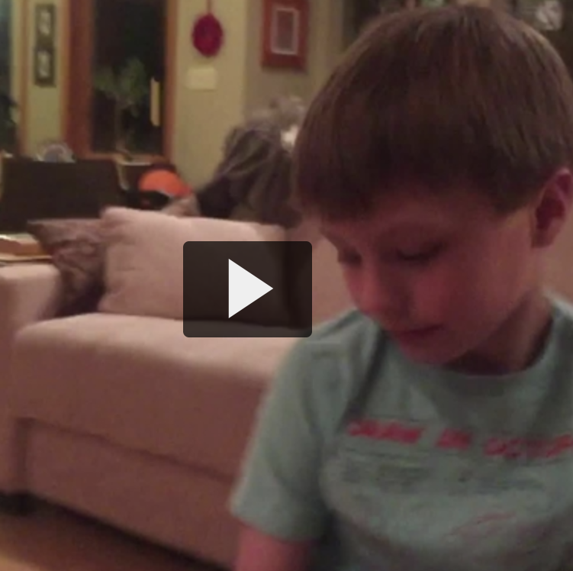
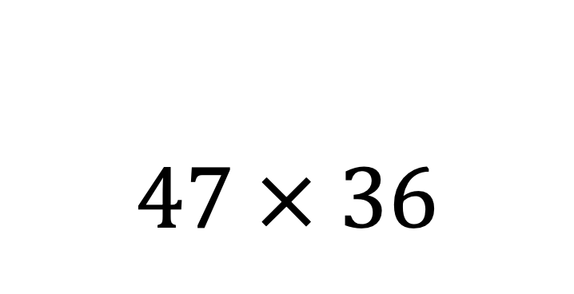
$$47 × 36$$
Video link

Slide 11
Starting with Large Division, Unit 3 packet p. 38
Sharing
You don’t know the group size. You do know the number of groups.
Works well to model with base ten blocks
Use models first and then have students record
Measurement
You don’t know the number of groups. You do know the group size.
Works well to model with open arrays
Use models first and then have students record
Notes:
Standard Algorithms for Multiplication (3 of 3): Open Array and Transition to Abstract (8 minutes)
Purpose:
Continue semi-concrete work with open arrays, then show the bridge to the ABSTRACT standard algorithm (the vertical notation used in traditional multiplication).
Content Focus: 72 × 36
- Start with an open array: Draw a rectangle, label sides 72 and 36, divide it into partial products
- Show partial products visually: 70×30, 70×6, 2×30, 2×6
- Calculate and add each partial product
- Then show the SAME calculation written in standard algorithm notation:
```
72
× 36
-----
432 (72 × 6)
2160 (72 × 30, written with regrouping)
-----
2592
```
Van de Walle Chapter 13 Insight:
By Slide 8, students should understand that the standard algorithm is just a COMPACT way to record the partial products they already understand from the area/array models. The key to preventing errors later is maintaining this connection.
Facilitation Tips:
- Draw the open array first, calculate all partial products visually
- Then position the standard algorithm NEXT TO the array
- Use color or arrows to show: "See? 72 × 6 = 432, which appears here in the algorithm."
- Emphasize: "We're doing the same math. The algorithm is just a faster way to write it."
- If students are ready, briefly explain regrouping: "When we multiply 72 × 30, we get 2160. We write this in the 'tens place' position because 30 is three tens."
Caution:
Some students will still prefer the open array or partial products method. Validate that! The algorithm is efficient, but other representations are also correct and often easier to explain.
Timing: 8 minutes. By now, students should be following the logic fairly quickly.

Slide 12
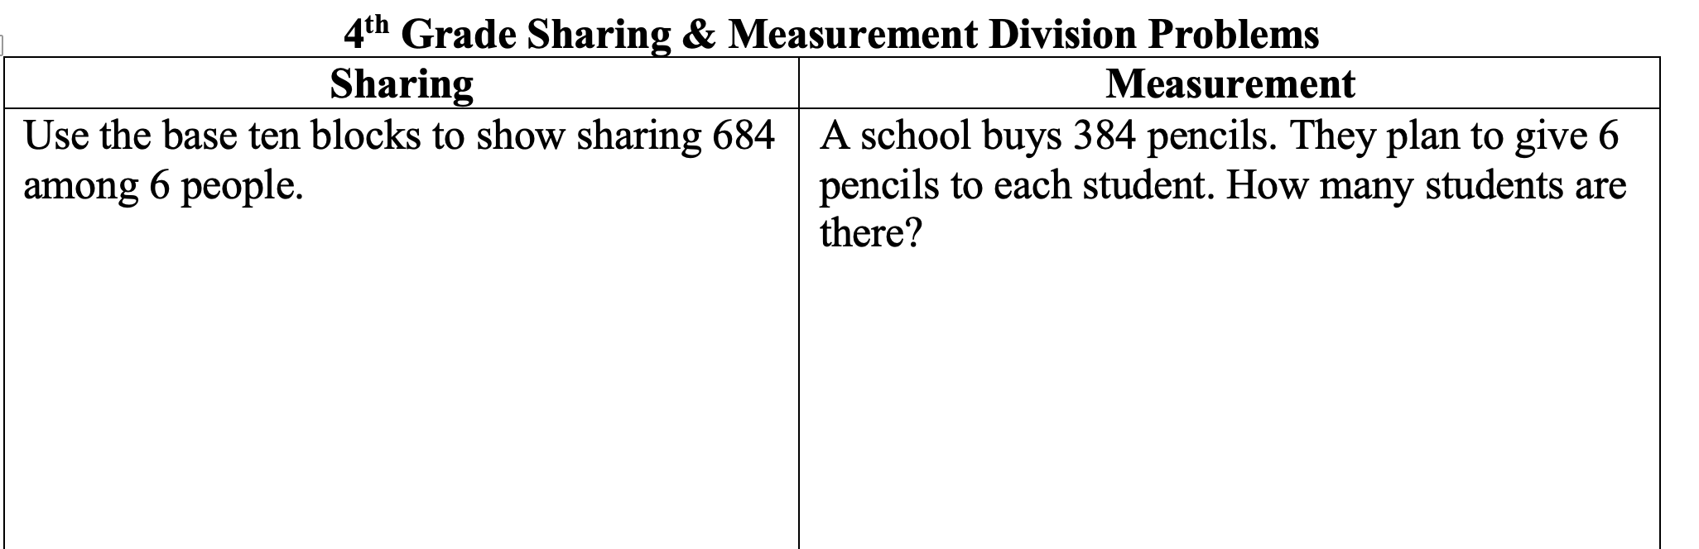
Starting with Large Division, Unit 3 packet p. 38
Notes:
Connecting Concrete and Abstract: Full Model Progression (12 minutes)
Purpose:
Explicitly show the ENTIRE progression from base-ten blocks through area models to the standard algorithm using ONE EXAMPLE. This metacognitive moment is crucial for solidifying understanding.
Content Focus: 47 × 36 (revisited with full progression)
What This Slide Should Contain:
1. BASE-TEN BLOCKS representation (top): 4 tens and 7 ones, arranged in a 36-group structure. Visually shows the product.
2. AREA MODEL (middle): Rectangle divided into 40×30, 40×6, 7×30, 7×6. Partial products labeled and added.
3. STANDARD ALGORITHM (bottom): The vertical notation showing same calculation in compact form.
Teaching Strategy:
- Point to each representation in sequence
- Say: "Here we see the SAME multiplication problem, represented three different ways."
- "The blocks show us the concrete reality: how many are actually there."
- "The area model lets us SEE the partial products before we write them."
- "The algorithm is the shorthand—it's the fastest way to write the same calculation."
Van de Walle's Big Idea:
Chapter 13 emphasizes that ALL THREE representations should be available to students. Some students will always prefer to draw an area model or use blocks. That's fine! The standard algorithm is efficient, but it's not superior—it's just different.
Facilitation Tips:
- Use a document camera to show blocks, then draw models, then show notation
- Ask students: "What do you notice? Are we doing the SAME math each time?"
- Pause and let students see the connections themselves before explaining
- Celebrate: "By understanding all these ways, you now see multiplication from multiple angles. You're not just memorizing a trick—you understand what's happening."
Critical Timing Point:
This slide is your opportunity to consolidate learning. Spend time here (12 minutes is justified). Students who leave class understanding these connections will have strong, flexible number sense. Students who only see the algorithm without the models will struggle with more complex problems and real-world applications.
Assessment Opportunity:
Watch for students who see the three representations and nod in understanding. These students are ready to fluently use the algorithm. Students who are still confused about the connections may benefit from additional small-group work with models before moving to independent practice.

Slide 13
Until Next Time
No new reading
If you haven’t read VdW Division strategies
Lesson 3 analysis due Sunday

